Slide 1
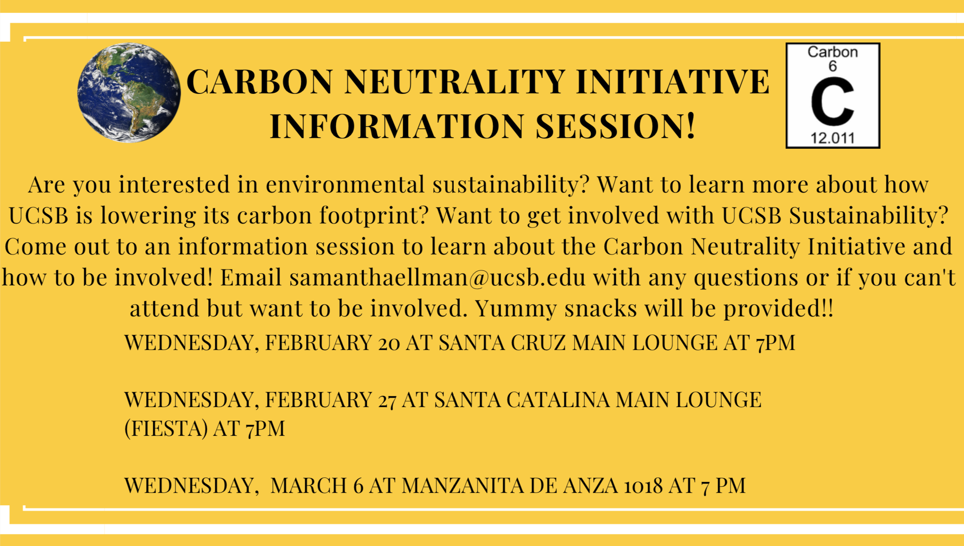
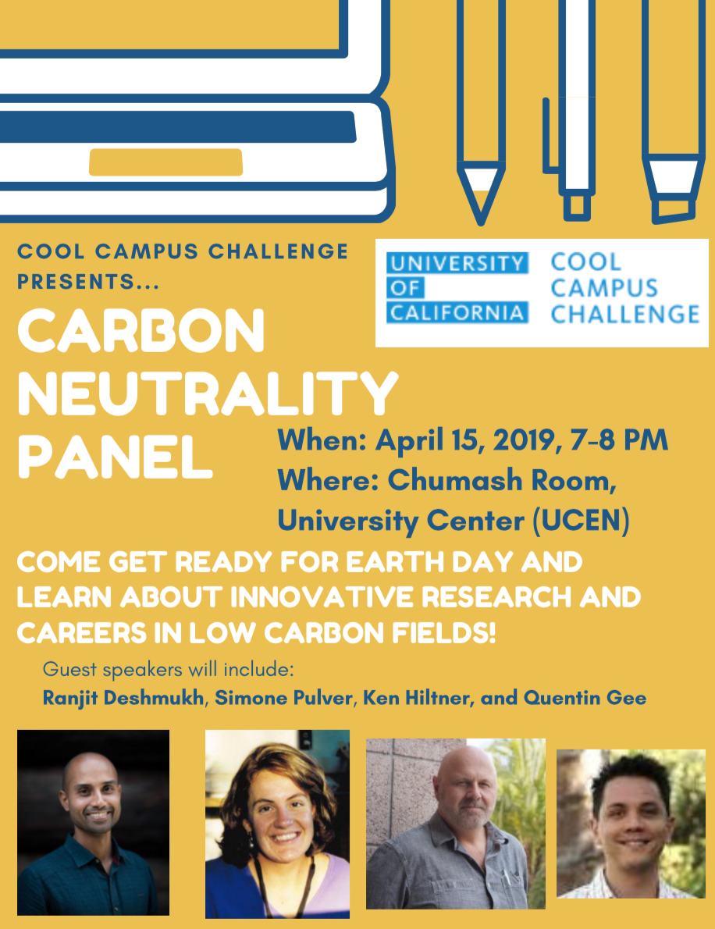
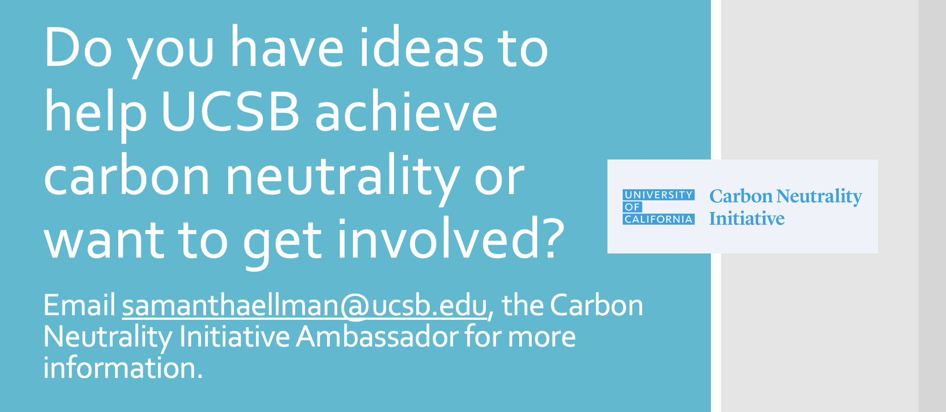
Increasing Student Engagement in UC Santa Barbara Carbon Neutrality Initiative (CNI) Samantha Ellman, University of California Carbon Neutrality Initiative Fellowship
Introduction
Materials and Methods
Results and Outcomes
Throughout my fellowship, I organized events, wrote for the UC Santa Barbara Climate Scoop, tabled on behalf of the Carbon Neutrality Initiative at campus events, and campaigned for the Cool Campus Challenge during the month of April.
In an effort to increase student awareness of and involvement in CNI, a number of advertising and marketing techniques were utilized, including in person tabling at various events and in common spaces on campus; Facebook posts on the UC Santa Barbara Sustainability page and various UC Santa Barbara Facebook groups; flyers in residence halls; Did You Knows in campus dining facilities (Figure 3); hosting events; signing students up for the UC Santa Barbara sustainability newsletter; and class and email announcements. In addition, a banner was made to use at events and tabling opportunities to draw attention and create a memorable appearance.
To engage students in CNI, I helped planned forum on UC Santa Barbara’s Sustainability Plan, and a carbon offsets workshop.
To help build engagement in the Cool Campus Challenge specifically, I hosted a informational sessions about the challenge in an effort to increase interest before the campaign begun. (Sample half sheet flyer seen in Figure 1 - created using Canva). These informational sessions were held in winter quarter. From these information sessions, eight students expressed interest in helping advertise the Cool Campus Challenge throughout the month of April. At the end of winter quarter, we met to discuss strategies for increasing student participation in the Cool Campus Challenge and continued meeting throughout the challenge to brainstorm further. In addition to using advertising strategies previously stated, we increased participation by:
Tabling at the each of the four dining commons once a week during the lunch period (Monday-Thursday)
Tabling at the Isla Vista Food Co-Op the first Friday of the challenge
Hosting a Carbon Neutrality Initiative Panel with four UC Santa Barbara Faculty and Staff members that was focused on research and instruction in carbon neutrality and had time for student questions (Flyer seen in Figure 2)
Film screening of “Dive!” co-hosted with UC Santa Barbara’s FoodCycling, a food recovery group on campus
The film was about the phenomenon of food waste in the United States, with themes including greenhouse gas emissions from food waste in landfill
LED Light Giveaway on Earth Day with UC Santa Barbara Associated Students Environmental Affairs Board for all students who signed up for the challenge and took the action “Participate in the Million LED Challenge”
In the Cool Campus Challenge, UC Santa Barbara ended the competition with 2,668,195 points and a total of 1,518 participants.
Figure 1
In the first Cool Campus Challenge that took place in 2015, UC Santa Barbara had a total of 1,423 participants. Increasing our number of participants by almost 100 individuals was a huge success because the competition went from being held over a 10-week period in 2015 to only a 4-week period in 2019.
This participation resulted in 1,230,618 pounds of carbon dioxide savings and a greater awareness of the UC system’s efforts to be carbon neutral, as well as how students can lower their personal carbon footprint.
Future Goals
Although I will no longer hold the position of the CNI Engagement fellow in the 2019-2020 academic year, I hope to remain involved in the initiative. One way is by authoring a “Carbon Neutrality Initiative Engagement Fellow Guidebook/Toolkit” for the future fellow. In this guide, I have outlined some of the goals that I have, including starting a Carbon Neutrality Initiative Club that can be chaired by the fellow; allowing the CNI Engagement fellow to have a focused project that he/she/they undertake throughout the academic year; and collecting more concrete and quantitative metrics to measure the success of the role.
Figure 2
Project Goals
As the CNI Engagement fellow, my main goals were to increase student awareness of and involvement in CNI and increase student involvement in the Cool Campus Challenge as compared to the first Cool Campus Challenge in 2015.
Acknowledgements
I would like to thank Jewel Persad, the UC Santa Barbara Sustainability Manager and Katie Maynard, the UC Santa Barbara Sustainability Coordinator for supporting me throughout the duration of my fellowship. I would also like to extend a special thank you to Cooper DiNapoli for his help with the Cool Campus Challenge. In addition, I would like to thank everyone at UC Office of the President for supporting all of the Bonnie Reiss Carbon Neutrality Initiative fellows at every UC campus.
Figure 3
Notes:
Phase II: In-depth assessment (similar to LEEDS) and information exchange with entire research group. Inform staff of support services, shared equipment, onservation impact, altered techniques or materials. Inquire: needs and concerns
Phase III: Follow up

